Slide 1
IoT OTA Update Project Proposal
Mark Ding | March 11, 2020

Slide 2
Agenda
OTA Introduction
Bluetooth OTA
Zigbee OTA
Proprietary OTA
Z-Wave OTA
Proposal on Improvement of OTA Update

Slide 3
OTA Introduction
OTA (over-the-air) is a mechanism for remotely updating IoT device with new settings or firmware
The OTA Update mechanism is a core part of a IoT system’s architecture
OTA architectures for IoT
It contains two major part: Client and Server.
Client: It can be the IoT end device or gateway which is capable of receiving new firmware image from a remote server.
Server: It is responsible for sending firmware image to the client. It can be cloud or local host that is able to locally connect with client device.
Existing Implementation
Server:
Host app runs on laptop, connects with a wireless device via UART/SPI.
Sending firmware image through the wireless device to the client device.
Client:
Wireless client device join the network or directly communicate with server to receive the firmware image over-the-air.
We would like to introduce more in details for various wireless product at following sections

Slide 4
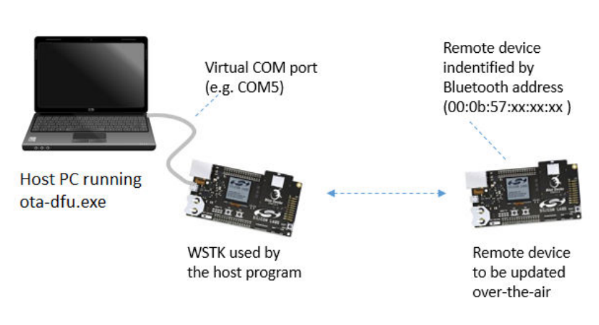
Bluetooth OTA
Client – (GATT Server in Bluetooth)
WSTK running in SoC mode
Application Bootloader + AppLoader
External or internal flash as image storage space
Run batch file to create bootloader files
Server – (GATT Client in Bluetooth)
WSTK running in NCP mode
Standalone DFU Bootloader
ota_dfu App running on Windows with Cygwin.
Communicating between NCP device and PC host via BGAPI
OTA Update
The mesh OTA update is not defined by SIG
Run ota-dfu from host along with client device mac address
It takes 33 seconds to finished the update

Slide 5
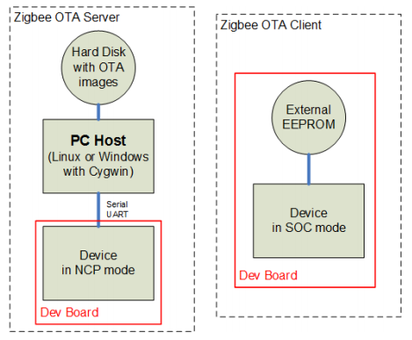
Zigbee OTA
Client
WSTK running in SoC mode
Application Bootloader
External or internal flash as image storage space
Require software configuration to enable OTA related plugin
Server
WSTK running in NCP mode
Standalone xmodem Bootloader
Z3Gateway host App running on Windows with Cygwin
Communicating between NCP device and PC host via EZSP
OTA Update
Server form the network by command line input
Client join the network by command line input
Start the OTA progress by command line at client
It takes 5.5 minutes to finish the update

Slide 6
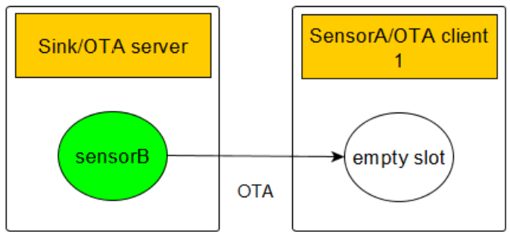
Proprietary OTA
Client
WSTK running in SoC mode - Sensor
Application Bootloader
Require software configuration to enable OTA related plugin
Server
WSTK running in SoC mode - Sink
Application Bootloader
Require software configuration to enable OTA related plugin
External or internal flash as image storage space
OTA Update
Program image file to server WSTK by commander tool.
Server form the network by command line input
Client join the network by command line input
Start the OTA progress by command line at server side

Slide 7

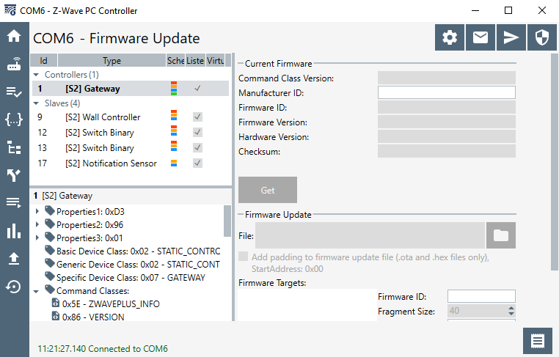

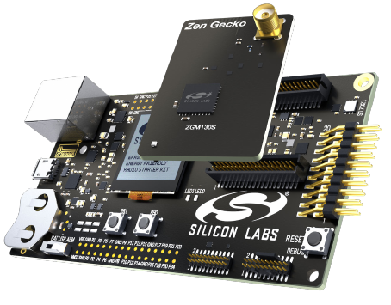
Z-Wave OTA
Client – (Slave in Z-Wave)
WSTK running Soc mode - SwitchOnOff
Application OTA Bootloader in hex file format
Flash Bootloader sample keys by commander tool
Server – (Controller in Z-Wave)
PC Controller GUI tool running on Windows
Need a UZB7 USB dongle attached to PC
Communicating between UZB7 and PC Controller via Serial API
OTA Update
Server forms the network by click button on the GUI tool
Client start joining the network by pressing a button
Server accept the request with Client SN input
Server start the OTA progress
It takes 10+ minutes to finish the update
Host PC Running Controller GUI Tool
UZB7
Slave

Slide 8
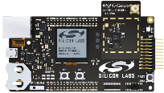
New IoT OTA Design Hardware Diagram
OTA Server
Host PC running application
OTA Client
Serial UART
Wireless Protocol
WSTK in NCP Mode
WSTK in SOC Mode

Slide 9
Proposal on Improvement of OTA Update
Bootloader
Both client Soc and server NCP WSTK use Gecko application bootloader.
NCP
We choose NCP at server side since it is popular design on Gateway and easy to maintain.
Host
Every host app can be built under Cygwin. Unique compiling environment
Script
Using Python 3.x to manage the whole OTA update progress at host side.
It can keep current host app without much changes to work with Python.
Make a xml or JSON as unique configuration file for various wireless protocol OTA update.
Network
Form and join network automatically, no need command line interaction.
Pro
We take advantage of each wireless product to make the OTA update better than before.
We make the unique way of OTA update across the products.
Simplify the OTA procedure and improve developer experience.
Con
It is a very time cost project as it makes a big changes across the various products.

Slide 10
Thank You

